Slide 1

The Impact of UI and UX Design on Web Application Quality: A Mixed Methods Study.
JH248828
Notes:
The title of my paper is the impact of UI and UX design on web application quality: a mixed method study

Slide 2
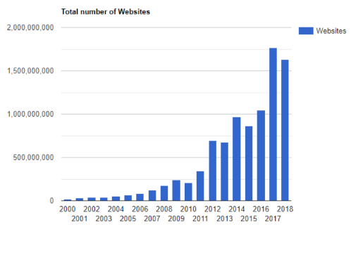
Background: The Proliferation of Websites and the Rise of Website Builders
The number of websites has increased exponentially with the launch of Web 3.0, leading to the creation of website builders for users to easily manage and alter their designs.
As of 2020, 43% of websites were using the website builder WordPress, an increase from 13% in 2011.
The target demographic for web builders is non-developers creating their first website.
The growing number of developers and non-developers makes understanding UX crucial for maximizing the potential of web applications.
The use of web builders can contribute to negative UX consequences, such as poor brand perception and decreased product value.
Notes:
This is background is mostly the same as my proposal
The rapid expansion of the internet with the launch of Web 3.0 has led to a significant increase in the number of websites. To make it easier for users to manage and customize their website designs, website builders have been developed. These builders allow users to simply drag and drop pre-made components into place, without the need for coding knowledge in HTML or CSS.
In 2020, 43% of websites used the website builder WordPress, up from 13% in 2011. This rise in popularity is likely due to the convenience and accessibility of these builders for non-developers creating their first website as these users may not have the same level of knowledge and expertise as experienced web developers.
For these non-developers, user experience (UX) is crucial in maximizing the potential of web applications. UX involves using user-based metrics to evaluate whether a user interface (UI) design enables effective interaction and meets user requirements.
Website builders may limit the effectiveness and uniqueness of design by only offering a set of predetermined tools. Negative UX can impacts brand perception and decreases product value, while positive UX can help a website stand out through increased traffic or search engine optimization.

Slide 3

Research Questions
What are the most effective design elements for improving the UX of web applications?
The effectiveness of design elements varies depending on site requirements.
Incorrectly using elements negatively impacts UX.
How can these design elements be understood by a non technical audience?
Researchers have used survey papers or models to limit the scope of their research
Its important to cater research in this area to the growing number of new web builder users
Notes:
The impact of each design element on UX can vary depending on the specific requirements of a website. For instance, an online newspaper may require more emphasis on typography than an online art gallery.
Therefore, it is crucial to identify the most effective design elements for a particular website to enhance it’s UX.
Moreover, using incorrect elements on a website can negatively impact UX, which can become a common mistake for less technical users.
My literature review revealed various approaches that researchers have used to make design elements understandable to non-technical users. Some have limited their findings to specific research models such as the Technology Acceptance Model or conducted surveys of numerous papers. However, despite these efforts, researchers often use vague terminologies and concepts that only developers or fellow researchers can understand.
As a result, web builder users miss out on valuable knowledge. Therefore it must be understood how this research can be understood by this growing group of users
Therefore, it is essential to bridge the gap between research and non-technical users to ensure that this growing group of users can benefit from research insights.

Slide 4
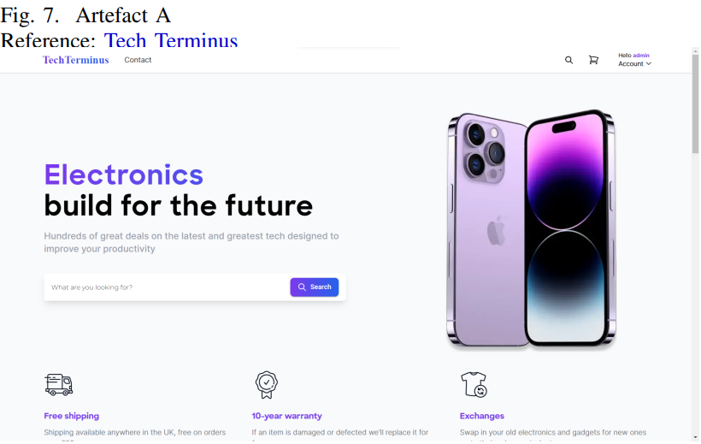
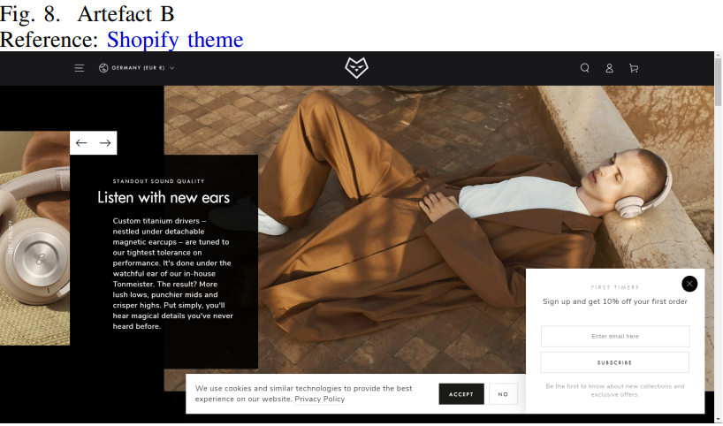
Artefact: Overview
Two e-commerce sites
Artefact A used informed design alterations
Artefact B made using Shopify
Technology stack
React.js
TailwindCSS
Node.js
Express.js
MySQL
Deployment
Heroku
ClearDB
Notes:
The artefacts used in this paper were two e-commerce websites
Artefact A had specific alterations to it’s design informed by the literature review Including, images in and out of the scene, a colour theory-based colour palette, animations and a call to action section.
While Artefact B was created using a website builder, specifically a theme from Shopify, which is a popular e-commerce specific website builder.
E-commerce was deemed the most relevant genre of application to choose given its rising popularity, and that building an online business is one of the most popular uses of web builders.
Artefact B is included strictly for comparison only and is not credit as the work of this paper and therefore artefact A will be discussed.
Artefact A includes all the standard features seen in e-commerce sites, such as login, registering, searching, filtering, a cart and a checkout system.
Artefact A’s technology stack consists of React and Tailwind for the front-end and Node, Express and MySQL for the back-end. Heroku and ClearDB used to deploy the build and database.
All authentication systems are encrypted using Node’s Crypto package before being stored, utilising hash, pepper and salting.
HTTP requests are handled using Axios.

Slide 5
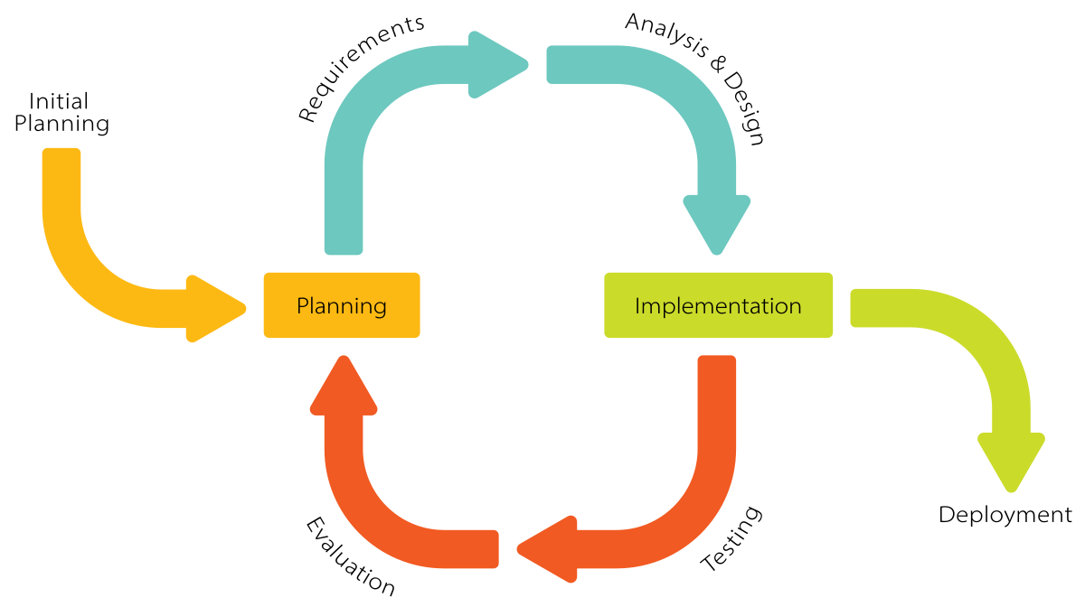
Artefact: Development Lifecycle
Incremental
Similar approach to agile
Suitable for an artefact where the requirements are unlikely to change
Allows for frequent feedback and refactoring
Notes:
The artefact was developed using an incremental development lifecycle.
This approach was considered the most suitable as it enabled the artefact to be divided into sections based on its features
Although similar to the agile approach, it was better suited for a situation where the requirements of the artefact were not expected to change during development.
With this approach, individual features could be iteratively improved, rather than completing everything at once, as in a Waterfall lifecycle.
Additionally, this allowed each feature to receive user feedback throughout the development process, enabling them to be refactored as necessary.

Slide 6
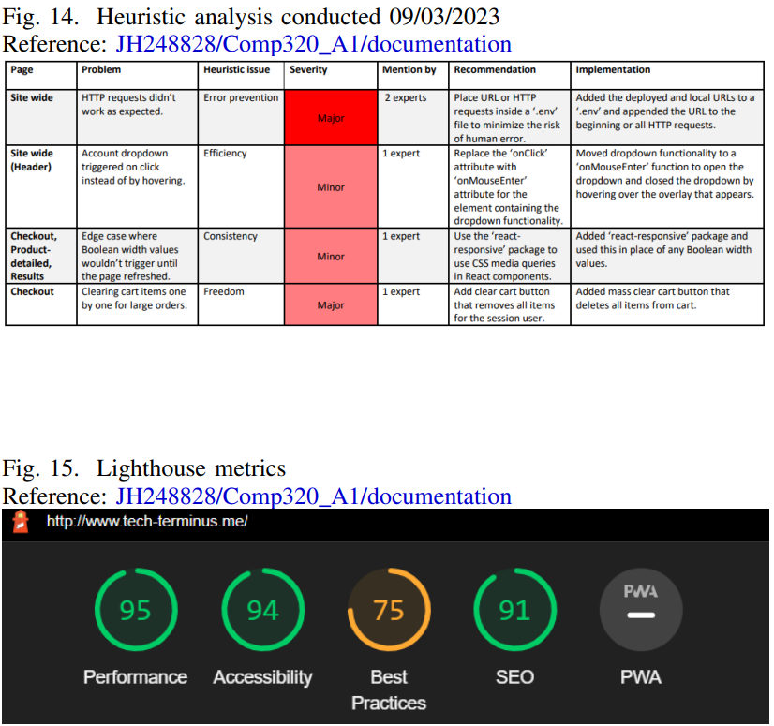
Artefact: Testing and validation
Unit testing
React.js testing library
Integration testing
React.js testing library
Acceptance testing
Heuristic analysis
Usability testing
Google Chrome developer tools
Notes:
The artefact underwent unit, integration, acceptance, and usability tests.
The unit and integration tests were scripted using React.js's testing library, which is built on top of the DOM testing library.
These tests covered the search and cart functionality, assessing both their individual performance and their integration with other features such as the product listing.
These included confirming that the search query correctly redirected users to a subsequent page with the query, and the various API calls from the cart such as adding, updating, and deleting products.
For acceptance testing, a heuristic analysis was conducted alongside the study, followed by refactors based on the identified issues.
These refactors included minimizing HTTP request errors by using a .env file, using a media query package to prevent an edge case with Booleans not updating, and adding a mass clear cart button.
Finally, usability was evaluated using Google Chrome's developer tool, Lighthouse. The evaluation measured several key metrics, including accessibility, which takes into account image alt text, ARIA labelling, and screen reader compatibility.

Slide 7
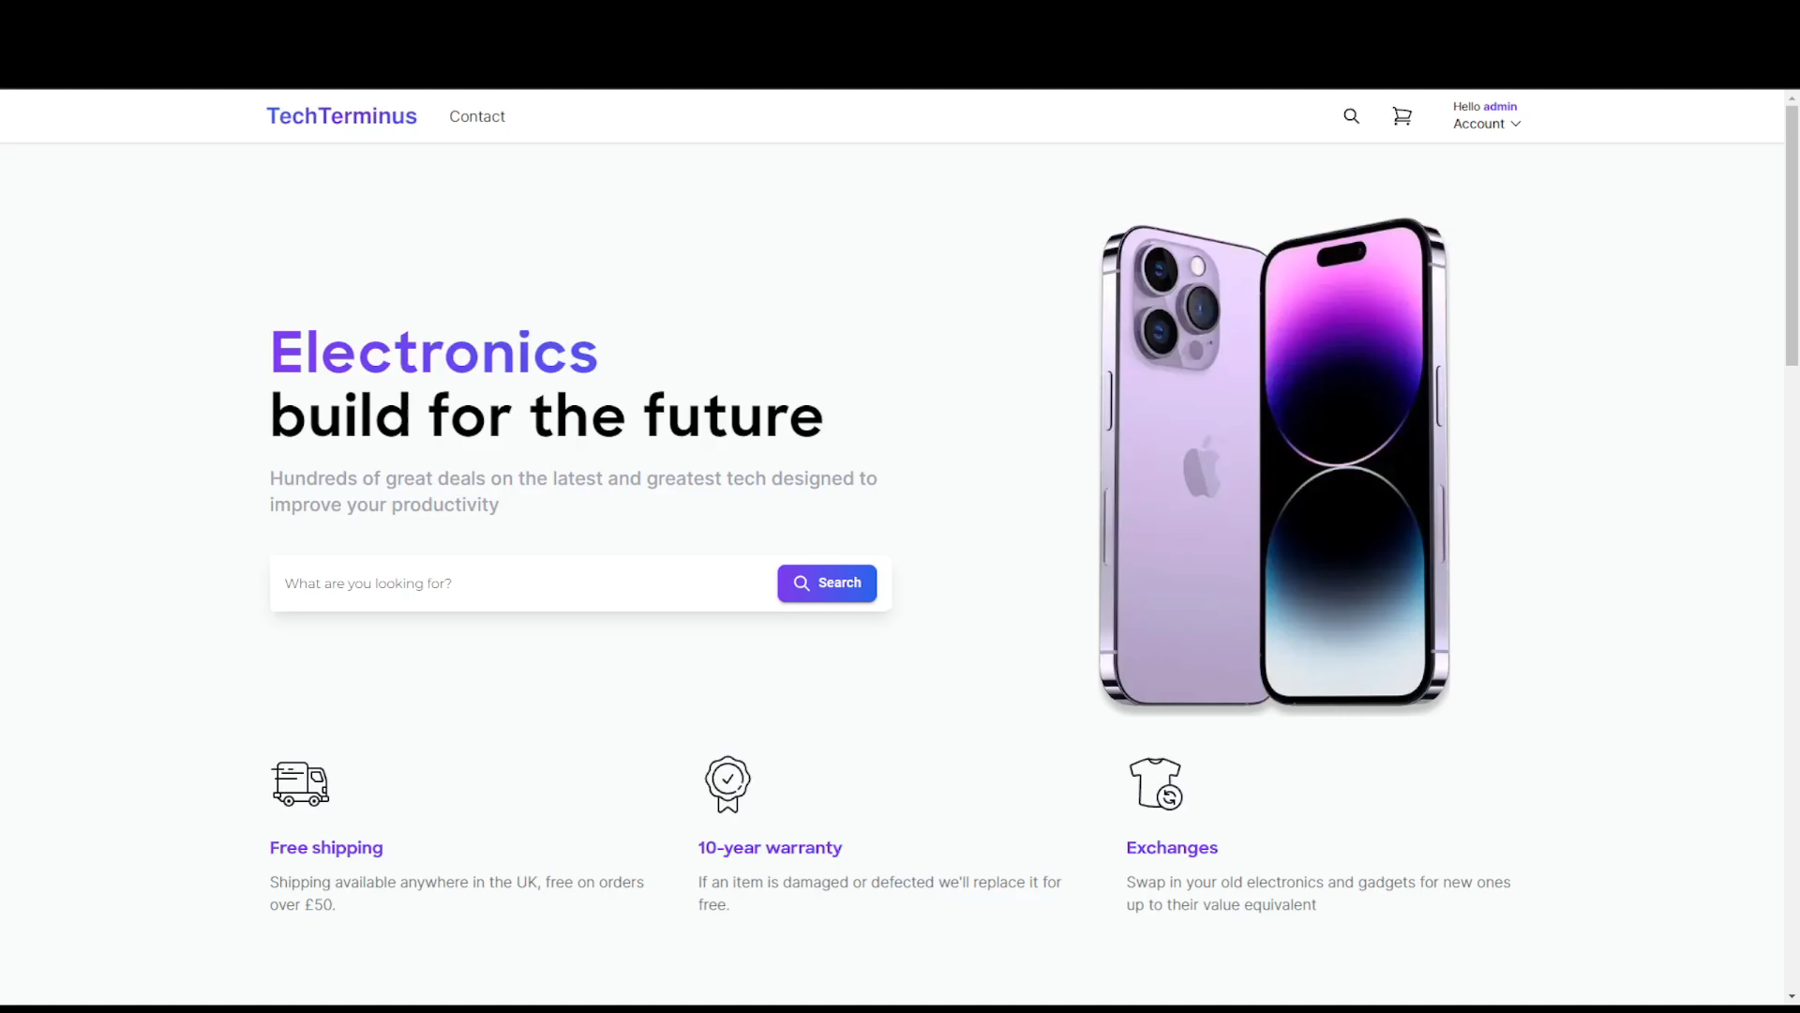
Artefact: Technical Demo
Notes:
This is my demo for artefact A
I've already logged into a premade account for the sake of the demo.
All accounts are encrypted and stored to the SQL database.
As you can see the home page includes a large search bar and product image.
Then further down is a list of products.
Going back to the top you can search a product like a laptop for instance.
Then you will go to a results page.
This results page can then be filtered alphabetically, by price or by name.
When clicking a product a page to view it will appear, the by clicking add to cart the icon in the top right will update.
Then ill add another product to the cart to test, this time a phone.
Now by clicking the icon you can see everything in your cart along side the checkout form.
Products in the cart can be updated, deleted individually or cleared with the clear cart button.
You can either complete the form or empty the cart to return to the previous page or just logout.

Slide 8
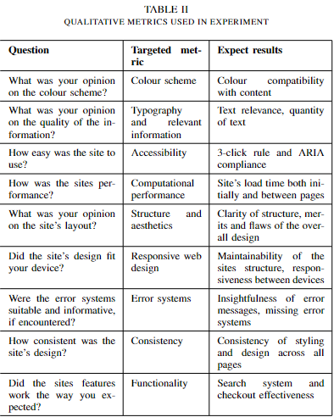
Methodology
A/B test and thematic analysis
Tasked with collecting several different products and reaching the end of the site's product life cycle
A/B test allowed all core features to be tested
Qualitative questionnaire using Microsoft forms
Artefact A used a click map
Notes:
The study was divided into two parts an A/B test and a subsequent thematic analysis.
The A/B test compared the two e-commerce sites artefact A and artefact B.
Participants were tasked with selecting several different products from different categories and adding them to the sites basket or cart system
They would finish this task by reaching the site’s checkout page after selecting their products.
Purchasing products was not required and was actively discouraged.
This method allowed each of the sites core functionality to be tested from; searching, filtering, updating and deleting products.
After completing their task they filled out a qualitative questionnaire with Microsoft forms.
Artefact A also used a click map from Microsoft Clarity to provide additional data on which elements were used the most during testing.

Slide 9
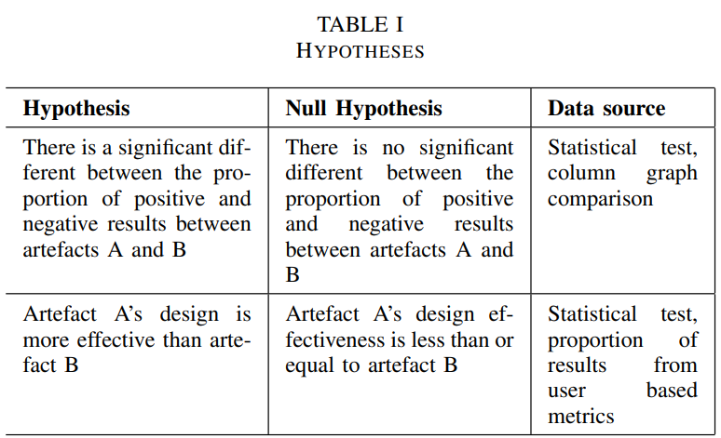
Hypotheses
Notes:
There were two key hypotheses used in my experiment.
Firstly, that "there is a significant difference between the proportion of positive and negative results between artefacts A and B".
This was informed by comparing the P values of the two sample proportional test and direct comparison between the two column graphs.
The null hypothesis was that there was no “significant different the proportion of positive and negative results between artefacts A and B”.
The second hypothesis is that “Artefact A’s design is more effective than artefact B”.
This was also informed by the statistical, as a less significant P value indicates that artefact was more effective overall.
The effectiveness of specific metrics was informed by comparing that metric across both graphs.
This null hypothesis was that “neither design was more effective than the other”.

Slide 10
Ethics
General data protection act
Disclaimer at the beginning of each form
Brief
Debrief
Consent form
3 week removal period
Anonymized data
Login and registering
Artefact A – Pre made accounts
Artefact B – Registering not required
Notes:
The A/B test required active participation. In order to conform to GDPR, a disclaimer was included at the beginning of each form, informing participants that their responses would be part of the study.
Additionally, participants were given a brief detailing an overview of the study and its objectives.
A consent form had to be signed before taking part in the study, detailing the risks involved, and providing an overview of their task.
After completing the questionnaire, participants were given a debrief and a 3-week grace period. By providing a reference, they could be removed from the study.
They could also request a copy of their data at any time.
Any participant data was anonymized, and whenever participants were referred to, their names were listed as participant A.1 or B.1, for example, depending on their group.
While login and registering systems were not required for the task, both artefacts contained them.
To counteract this, pre-made accounts were used for artefact A, while artefact B's task could be completed without registering.

Slide 11
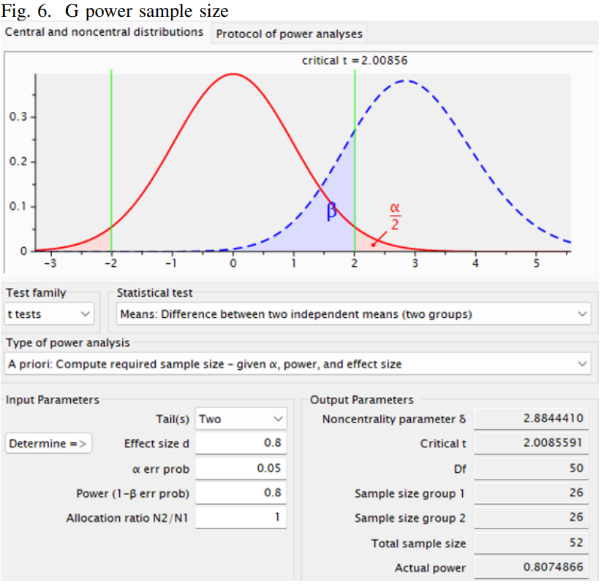
Data collection
Results export to CSV
Two sample proportional test
One column chart for each artefact
Comparing the number of positive results against the number of negative results
One column for each metric
Benjimini-Hochberg adjustment
Larger effective size of 0.8
26 participants per study group
0.05 error probability
Notes:
The results from the questionnaire were exported via a CSV file to Falmouth University's OneDrive.
To test the significance of each null hypothesis, a two-sample proportional test was conducted.
The test compared the proportions of positive results to the number of negative results using R’s ‘prop.test’ function.
Results were plotted into two column charts, one for artefact A and another for artefact B, using R’s ‘ggplot’ library.
With each column being a different metric
The X axis was the 9 metrics tested and the Y axis was the total number of responses.
To account for chance a Benjimini-Hochberg adjustment was applied to the results P value.
The sample size used was of a larger effect size of 0.8, given the answers were qualitative.
This results in 26 participants for each group totalling 52, at a standard error probability of 0.05.

Slide 12
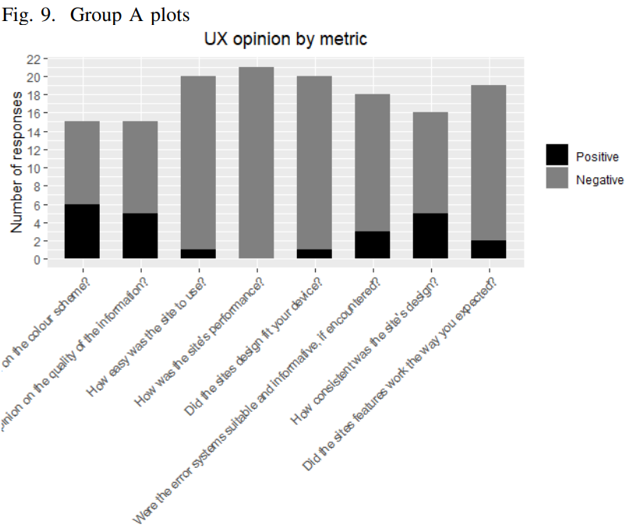
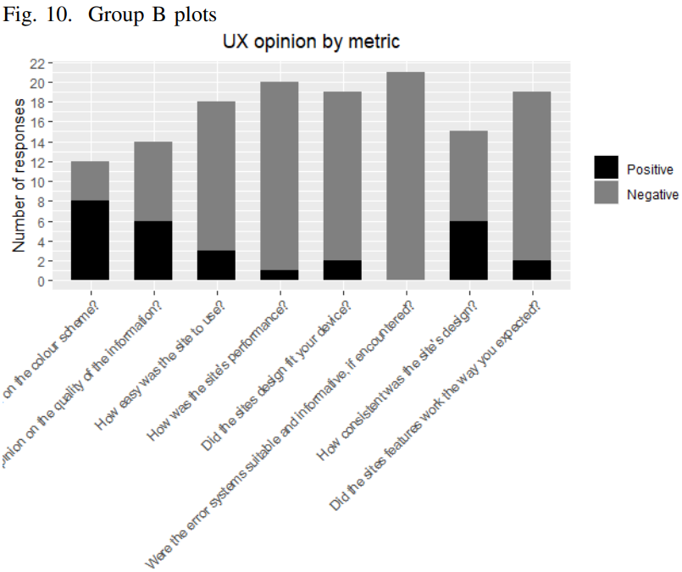
Results
Games students or similar disciplines
Result given P for mostly positive or N for mostly negative
42 out of 52 participants collected
21 per study group
Limited by individual enthusiasm and personal ability
Notes:
The participants collected for the study were mainly games students or individuals from similar disciplines at Falmouth University.
This demographic was crucial because it ensured that each participant possessed a certain level of technical knowledge, which prevented the study from being influenced by individual ability as opposed to design quality.
There were no other forms of demographic limiting.
After receiving all the results, each answer was marked positively or negatively by tallying them as P for mostly positive responses or N for mostly negative responses.
Although this system may create some bias, the complete results were still analysed; the marks were merely used to assign values to the column graphs.
Out of the total sample size of 52 participants, 42 conducted the study, which meant that each participant had a slightly greater impact than expected.
Each group received an even number of results, with 21 participants in each.

Slide 13
Influence of metric dependant on its role in the artefact
Server-side metrics received little difference in proportion
Client-side metrics had more larger differences in proportion
Previous research and this paper found metrics like “colour scheme, “typography” and “functionality” to be the key areas of discussion
Findings
Notes:
Each of the metrics exhibited varying proportions of positive and negative results.
Metrics such as "accessibility," "computational performance," "structure," and "error systems" showed little fluctuation in comparison to other metrics such as "colour scheme.“
This indicates that metrics have different levels of influence depending on their role in the artefact.
Metrics that are handled on the server side, such as "performance" and "error handling," have far less noticeable interactions with the participant.
This leads to common themes of limited responses where participants state that they "did not encounter any errors" or "did not notice any performance issues.“
On the other hand, other researchers have found that metrics handled on the client side, such as "layout," "typography," "colour," and "aesthetics," are the most commonly discussed areas when it comes to improving UX.
This paper yielded similar results, with "colour scheme," "consistency," and "functionality" showing the largest variations between the two artefacts.

Slide 14
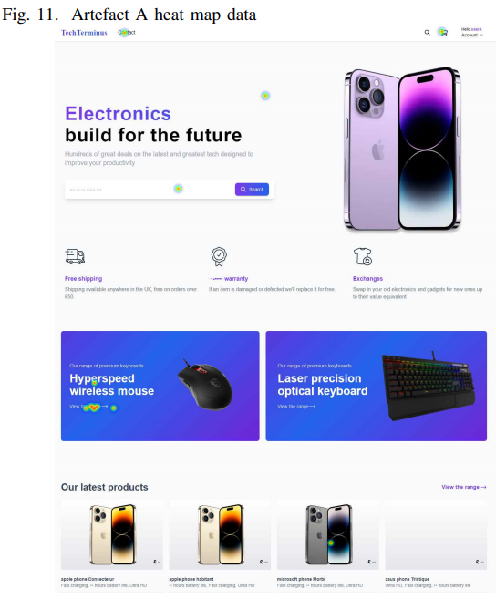
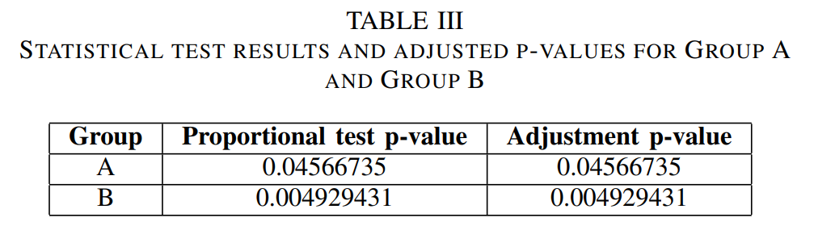
Statistical test results
Statistical test
Artefact A performed better overall
Artefact A’s P-value was less significant than B’s at 0.04 compared to 0.004
Heatmap
Index page received most interactions
Users followed common eye-tracking trends
Headers and hero sections have key importance
Notes:
Artefact A outperformed artefact B in all criteria except for "functionality," where the results were even.
This indicates that the informed design alterations made to artefact A improved its UX.
The data gathered from the statistical test also supports this, as the p-value for artefact A was 0.04, while the p-value for artefact B was 0.004.
This suggests that artefact B showed a more significant difference in proportion than artefact A, which rejects the second null hypothesis and supports the first hypothesis that one artefact performed better than the other.
The heatmap analysis revealed that content on the first page of artefact A received the most interactions, while elements in other areas had a lower concentration of clicks.
Additionally, adhering to common eye-tracking trends, such as placing the logo in the top left and account information in the top right, was equally important, as users tended to interact with the top left of the page, followed by the centre and then the top right.
This highlights the importance of key elements like headers and hero sections.

Slide 15
Discussion
What are the most effective design elements for improving the UX of web applications?
Server-side metrics should be treated as standards
“Colour scheme”, “typography” and “ease of use” within the first page of content
Apply metrics based on user requirements
How can these design elements be understood by a non-technical audience?
“Ease of use” is similar to usability
Improve usability by utilising eye tracking and having dedicated navigation elements
“Colour scheme” and “typography” are subjective
Both should match the requirements of the target audience
Consider the connotations of either when designing the application
Notes:
What are the most effective design elements for improving the UX of web applications?
Given that server-side metrics have fewer interactions with users, they should be treated more as standards in the areas of UX improvement.
Therefore, client-side metrics are the main area of discussion for this question.
The click map and study data suggest that "colour scheme," "typography," and "ease of use" are the most effective metrics, and they are most impactful within the first page of content.
Matching the user requirements to the application of these metrics is the most effective way to utilize these metrics.
For example, using a predominantly green colour palette on an environmental website will boost its UX as it most closely matches the expectations of the user.
This is evidenced by artefact B's more negative responses in these metrics. For its "colour scheme" specifically, it received negative feedback when referring to the predominantly dark color palette.
On the other hand, artefact A performed better in the colour scheme, matching its theme based on the connotations the site should portray.
As blue and purple provided themes of trustworthiness and creativity, more closely resembling the requirements electronics e-commerce users may have.
How can these design elements be understood by a non-technical audience?
Taking the three client-side metrics from the previous question, starting with "ease of use," non-technical users can better understand this as usability.
If the usability of a site is poor, users won't be able to complete their objectives, like purchasing a product, for instance.
Usability relies on the UI of the site being competent enough to allow enough functionality to use the site effectively.
Without it, all the other metrics are void as the site can't be used well enough.
Key elements to improve "ease of use" are including navigation sections like a header or call-to-action section, and furthermore, following common eye-tracking trends to place these elements in their most effective positions.
The "colour scheme" and "typography" are far more subjective metrics than "ease of use." This means there is no one-size-fits-all for either of these metrics.
To use these metrics most effectively, it is best to outline the requirements of the site's target demographic.
For example, an online tabloid will have a large emphasis on a clear and readable font compared to a site needing far less text.
The connotations of both the "colour scheme" and "typography" should also be considered.
Colour alters the user perception; for example, a largely red colour palette creates urgency, which is why it is often used in error systems.
Web builders often take theming into consideration; however, it is still the designer's responsibility to orientate their site to the requirements of their user.

Slide 16
Limitations and future works
Limitations
The nature of qualitative data
Sample size
Technical ability
Future works
Server-side metrics
Key client-side metrics
Re-conducting this study
How best to communicate technical design principles to non-technical users
Notes:
The study had several limitations.
Qualitative data tends to produce a wide range of responses, which is desirable, but may be affected by factors such as individual enthusiasm towards the subject.
The smaller sample sizes with a greater effect size resulted in fewer results and therefore fewer areas of discussion.
My personal ability to create Artefact A may have potentially contributed to a higher number of negative responses based on technical ability rather than design decisions.
Finally individual graphic settings may have altered the perception of either artefact.
Despite these limitations, the discussion created areas for future work.
Server-side metrics could be investigated to determine the best strategies for optimizing those systems to play a more significant role in design.
The key metrics of "colour scheme", "typography", and "ease of use" could be individually focused on and compared to an artefact with an altered colour palette or font, or an artefact with poor navigation compared to one with strong navigation, to determine their impacts, for example.
The same study could also be conducted again with its limitations mitigated.
Finally, researchers could focus on addressing the second research question of how to best communicate technical design principles to non-technical users.

